Slide 1

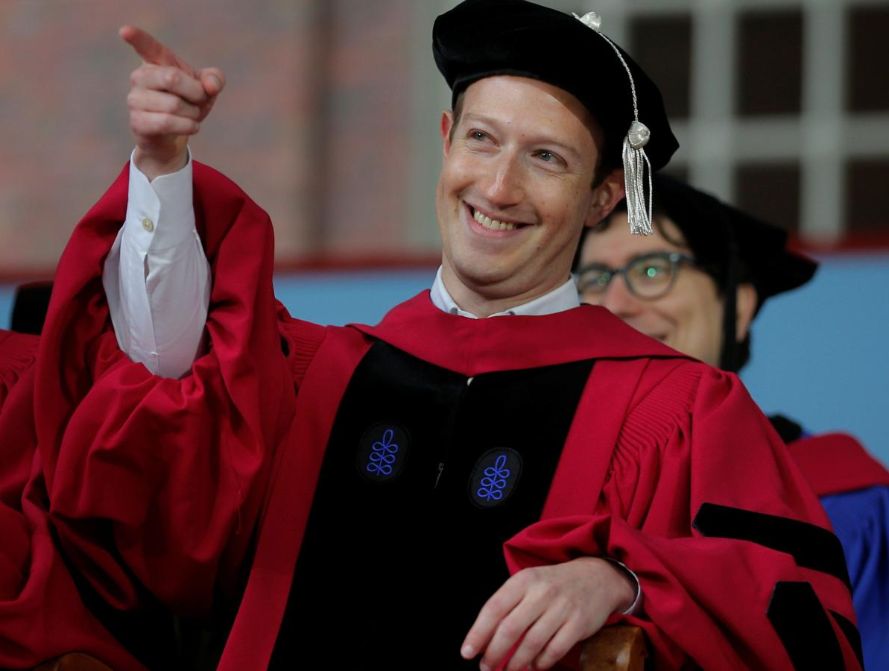
Welcome to the Coding Club!

Slide 2
Meeting Agenda
Club Introduction
Why code?
Club Constitution
Officers
Club Website
Python & IDE

Slide 3
Club History & Purpose
Founded in 2018 to foster the study of computer science within the CB South community
Teach code
Participate in coding competitions
Invite guest speakers from the industry
Coding Club

Slide 4


Why code?
Computer programming is the future as technology advances
Fastest growing job in the industry, shortage of software developers
Very high employment rate
High paying jobs, and work fewer hours
“Everyone should learn how to code – because it teaches you how to think” (Steve Jobs).
It’s fun and anyone can do it!

Slide 5
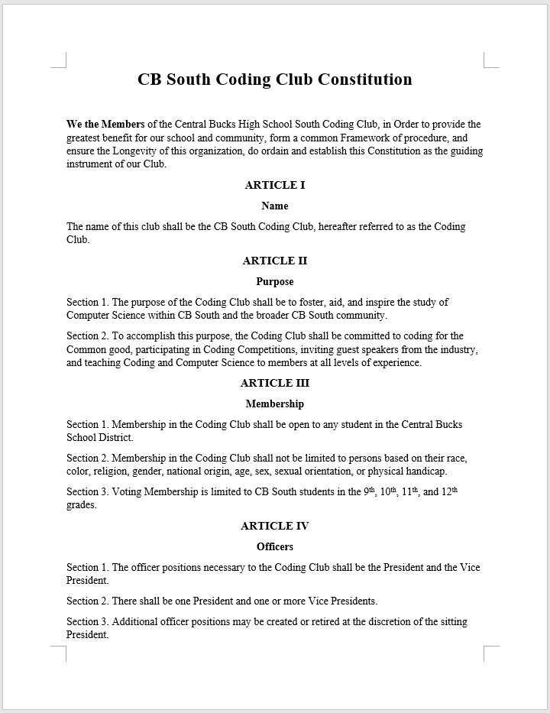
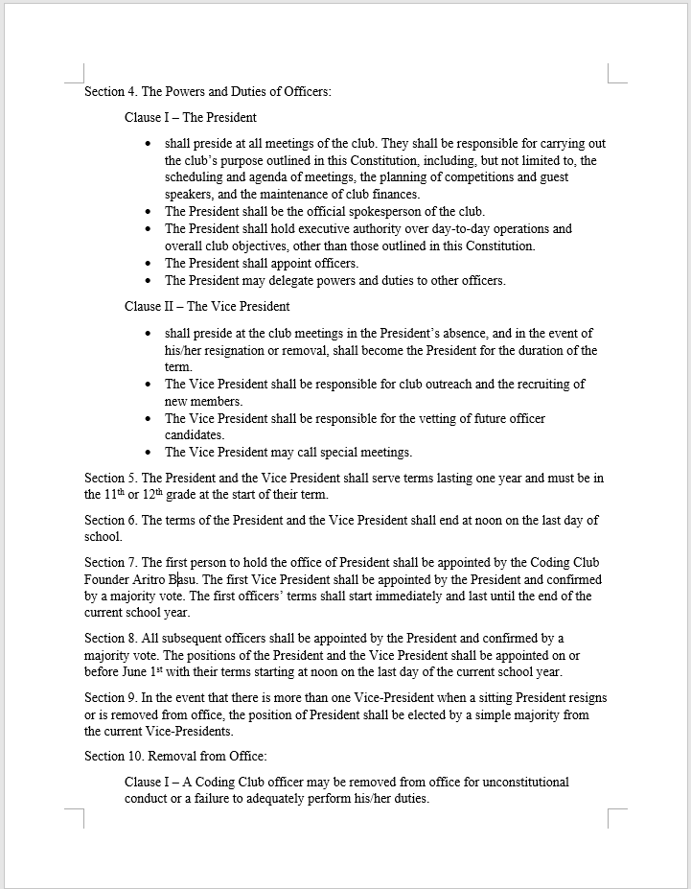
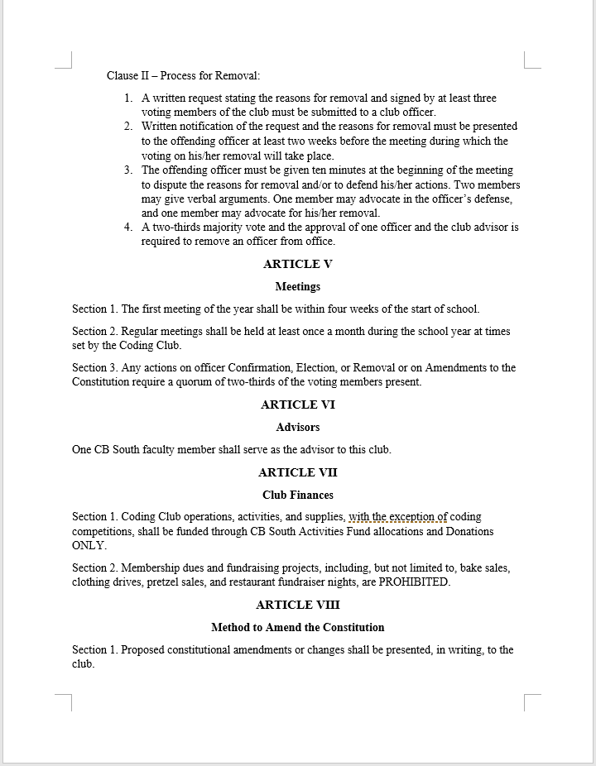
Club constitution

Slide 6
Officers
President
Vice President

Slide 7



Python Basics – Installing Python and IDE
School laptops-https://repl.it/languages/python3
Python 3.8.5-https://www.python.org/downloads/
PyCharm IDE-https://www.jetbrains.com/pycharm/download/#section=windows

Slide 8
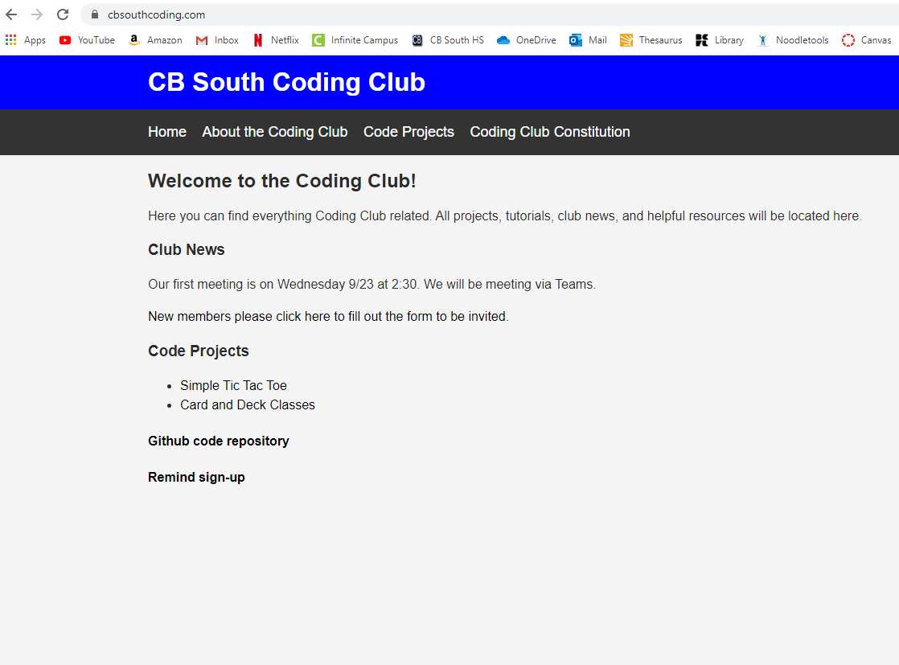
Club Website
http://www.cbsouthcoding.com

Slide 9


Other Resources
YouTube
Github: https://github.com/kevinhe5/CB-South-Coding-Club
http://www.cbsouthcoding.com
Coding Club Discord Channel: https://discord.gg/WPZWcDf

Slide 10
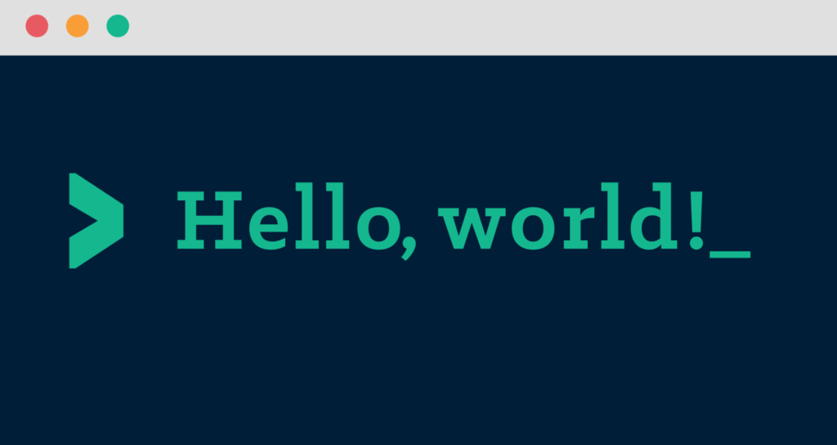
First program!
Create new project
Print “Hello world” to console

